Slide 1

EMPLOYEE APPRAISAL PROJECT
C++ PROGRAMMING

Slide 2


Team members
NITYA BANSAL 20BAI10348
SHANTANU KASANA 20bce10557
VEDISH KABARA 20BCE10407

Slide 3

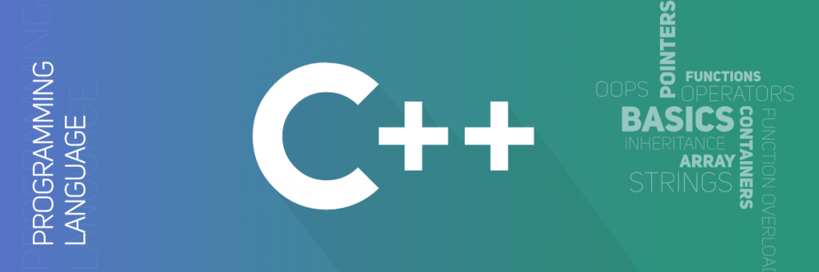
C++ Programming
C++ is a general purpose programming language and widely used now a days for competitive programming. It has imperative, object-oriented and generic programming features. C++ runs on lots of platform like Windows, Linux, Unix, Mac etc.

Slide 4
Introduction

Slide 5

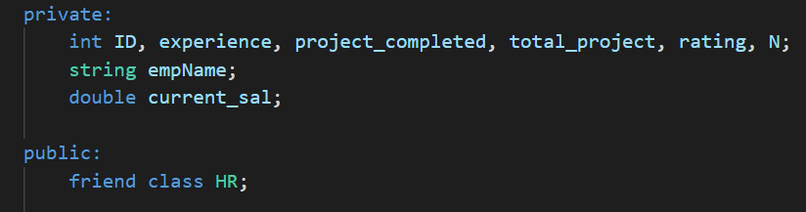
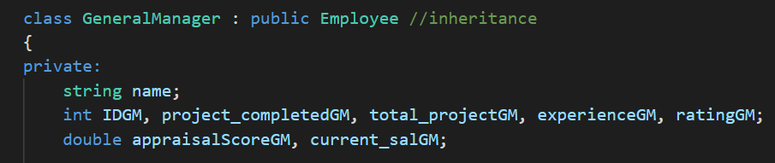
DATA ABSTRACTION
Data abstraction allows a program to ignore the details of how a data type is represented. Abstraction refers to the act of representing essential features without including the background details or explanations.

Slide 6

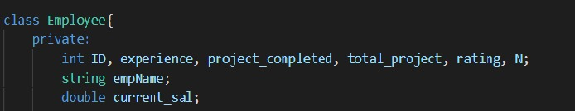
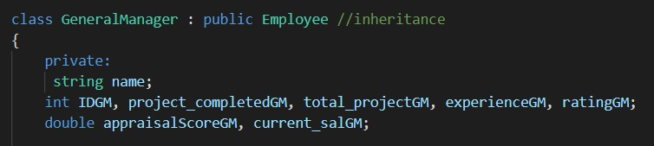
BASE CLASS-derived CLASS
A class can be derived from more than one classes, which means it can inherit data and functions from multiple base classes.
Where access-specifier is one of public, protected, or private, and base-class is the name of a previously defined class. If the access-specifier is not used, then it is private by default.
A derived class can access all the non-private members of its base class. Thus base-class members that should not be accessible to the member functions of derived classes should be declared private in the base class.

Slide 7

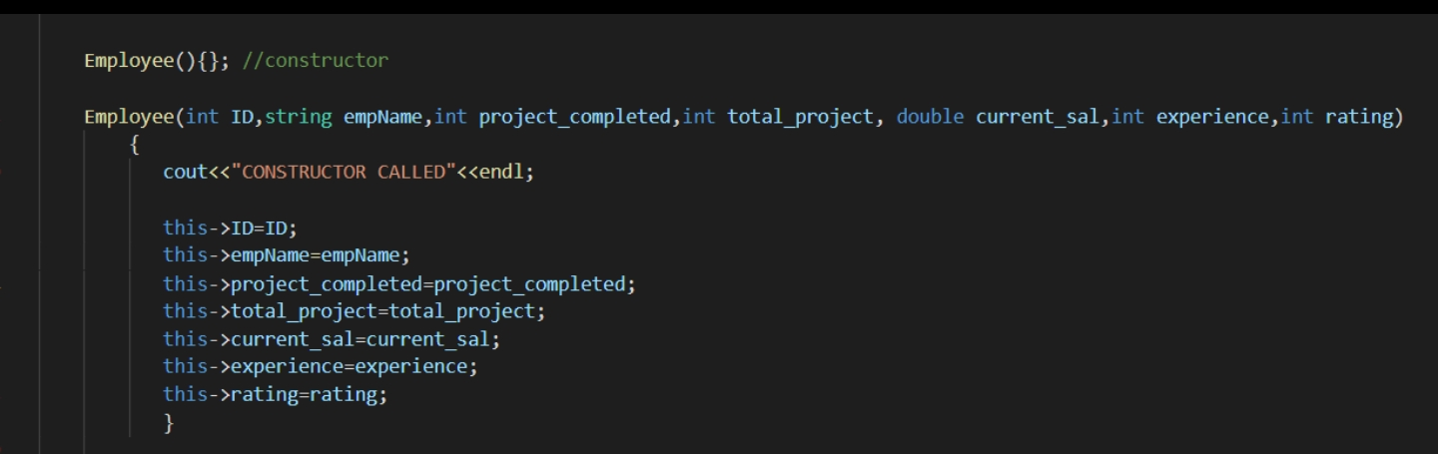
Title
CONSTRUCTOR
A CONSTRUCTOR IS A SPECIAL METHOD THAT IS AUTOMATICALLY CALLED WHEN AN OBJECT OR A CLASS IS CREATED.

Slide 8


destructor
Destructors in C++ are members functions in a class that delete an object. They are called when the class object goes out of scope such as when the function ends, the program ends, a delete variable is called etc.

Slide 9

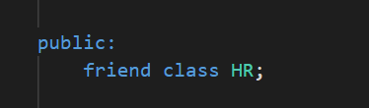
Title:
Friend class
A friend class can access private and protected members of other class in which it is declared as friend. It is sometimes useful to allow a particular class to access private members of other class. For example, a LinkedList class may be allowed to access private members of Node. .

Slide 10
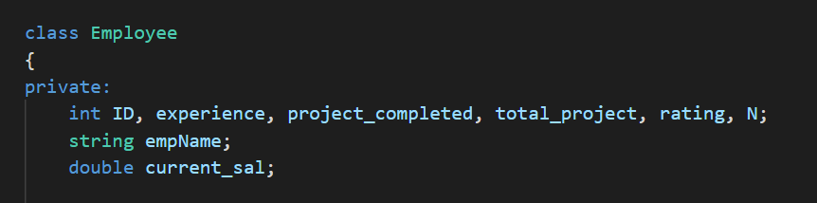
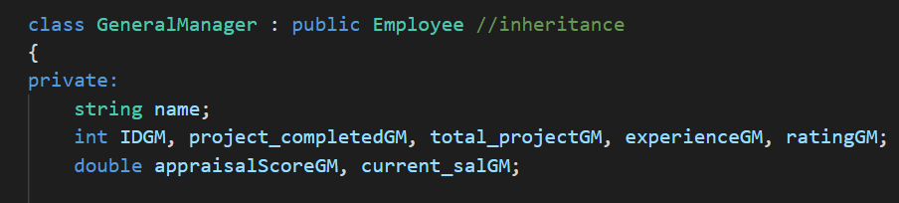
inheritance
The capability of a class to derive properties and characteristics from another class is called Inheritance. Inheritance is one of the most important feature of Object Oriented Programming. Sub Class: The class that inherits properties from another class is called Sub class or Derived Class. Super Class: The class whose properties are inherited by sub class is called Base Class or Super class.

Slide 11
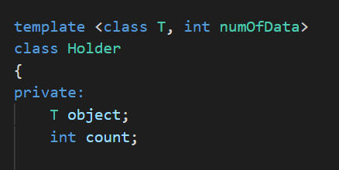

Template functions
A function template starts with keyword template followed by template parameters inside <> which is followed by function definition.

Slide 12
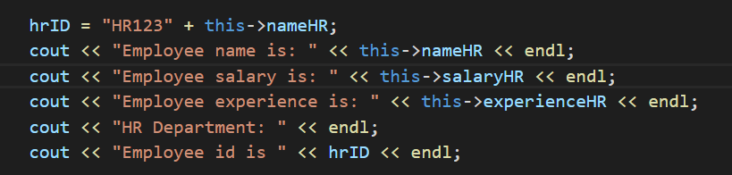
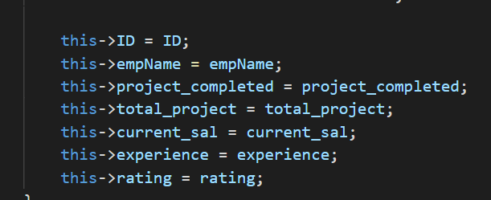
this Pointer
In C++ programming, this is a keyword that refers to the current instance of the class. There can be 3 main usage of this keyword in C++.
It can be used to pass current object as a parameter to another method.
It can be used to refer current class instance variable.
It can be used to declare indexers.

Slide 13
Strings
strings are used for storing texts.
A string variable contains a collection of characters surrounded by double quotes.

Slide 14
THANK YOU

Slide 15
Customize this Template
Template Editing Instructions and Feedback

